Slide 1
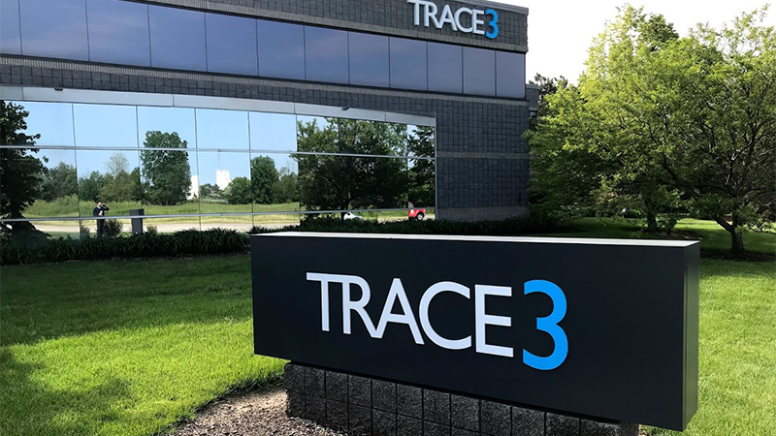
BUDT 723
BPA TEAM 1
Meeting Management
Tool

Slide 2



Agenda
# | Agenda Items
1 | Trace3 Problem Statement - Meeting Management Tool
2 | Planning and Analysis Phase Work
3 | Design Phase Work
4 | Proposed System Architecture
5 | Physical Data Flow Diagram
6 | Metric Library for Analytics Dashboard
7 | Sample Input and Output Design
8 | Implementation Plan

Slide 3
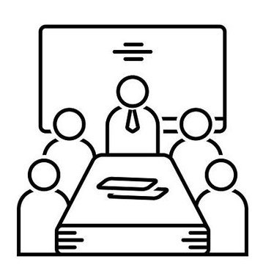

Trace3 Problem Statement - Meeting Management Tool
> Optimizing Stakeholder Time Commitment:
Develop a solution to gather meeting activity on Strategic Initiatives projects.
Avoid burdening stakeholders who have multiple high-priority commitments.
Avoiding manual data entry & collection (NetSuite, Smartsheets).
> Efficient Resource Allocation and Meeting & Participant Data Collection:
Design a streamlined system to optimize time and resource allocation.
Automated data storage, processing and retrieval for meetings & participants.
> Visualization of Metrics & Analytics:
Dashboard with insightful metrics, KPIs and analytics.
Enabling informed decision-making & efficient project scheduling.

Slide 4







Planning and Analysis Phase Work
> Understanding Trace3’s industry background.
> Information Gathering Techniques: Interviews, Observations
> Business process analysis for as-is (current) system.
> Statement of Work : Project Scope, Constraints, Challenges, Requirements
> Approvals : SOW, System Analysis Report
> Current tech stack :
> Opportunities :
Strategic Initiatives Team centric solution
Project and Resource optimization
Meeting, Participant, and Participation Activity data collection
Analytics Dashboard
Feedback loop

Slide 5




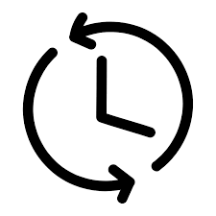
Design Phase
> Proposed Tech Stack :
Supervisor (Deployment)
CRON Job (Task Scheduling)
nginx (Reverse Proxy & Serving)
Python (Data Processing)
MySQL (Data Storage)
Redis (Caching)
API Calls to Teams, WebEx, Zoom, Outlook, Copilot - Firefly
> Approvals : System Design Phase Report, Evaluation Letter
> Diagrams and Matrices for System Design :
Data Flow Diagram
Entity Relationship Diagram
Physical Data Flow Diagram
Candidate Solutions Matrix
Feasibility Analysis Matrix
Input and Output Design
Data-to-Process CRUD Matrix
Implementation Plan
> Weekly meetings with Trace3 to build an iterative feedback loop.
> Working on the to-be (proposed) system.

Slide 6


Proposed System Architecture
> Data Collection :
Scheduled meeting data
Participant attendance
Participant activity
> Data Storage :
Meeting, Participant and Meeting Participation databases
> Data Processing :
Validation of meeting details
Derivation logic for metrics
> User Interface Dashboard :
Dashboard with analytics
Previous meeting data
Metrics and key performance indicators
> Feedback Mechanism :
Pre and Post-meeting survey for participants
Agenda fulfillment, feedback, questions

Slide 7
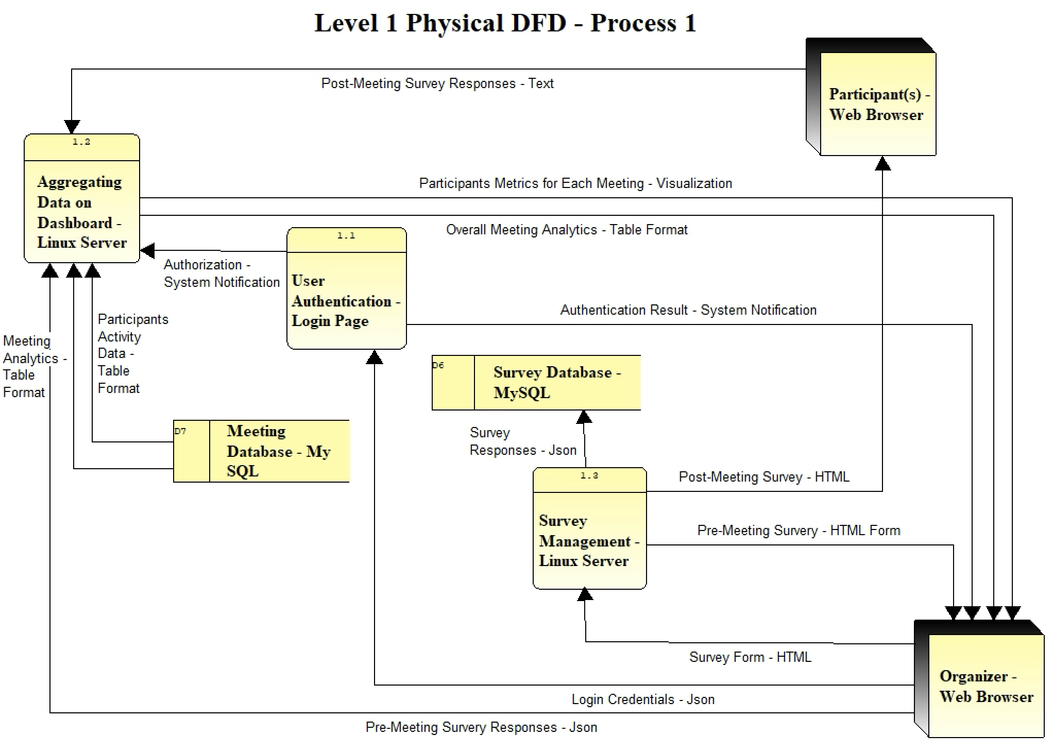
Physical Data Flow Diagram
Meeting and Survey Management :
User-Authentication: Verifying user identities to ensure secure access to the system.
Aggregating Data on Dashboard: Compiling and presenting diverse data related to human resources, projects and meetings.
Survey Management: Efficiently creating, distributing, and analyzing surveys within the system.

Slide 8
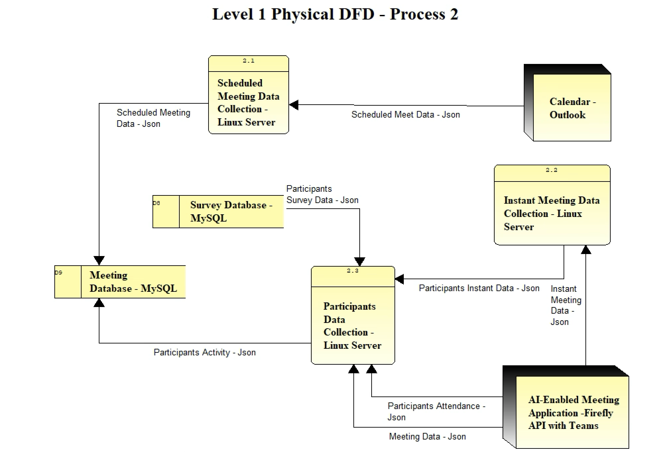
Physical Data Flow Diagram
Meeting Data Collection and Analysis :
Scheduled Meeting Data Collection: Data gathering for planned meetings.
Instant Meeting Data Collection: Capture of impromptu/instant meeting data for immediate reference and storage.
Participants Data Collection: Efficient collection of participant information for human resource management

Slide 9

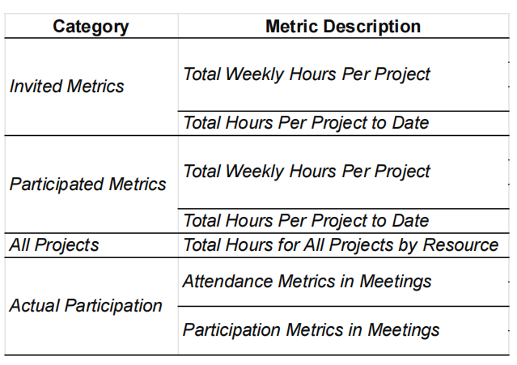
Metric Library for Analytics Dashboard
> Metric Name, Category, Description and Details
> Derivation Logic
> Data Source
> Periodic Update Frequency
> Feasibility
> Display type & order

Slide 10

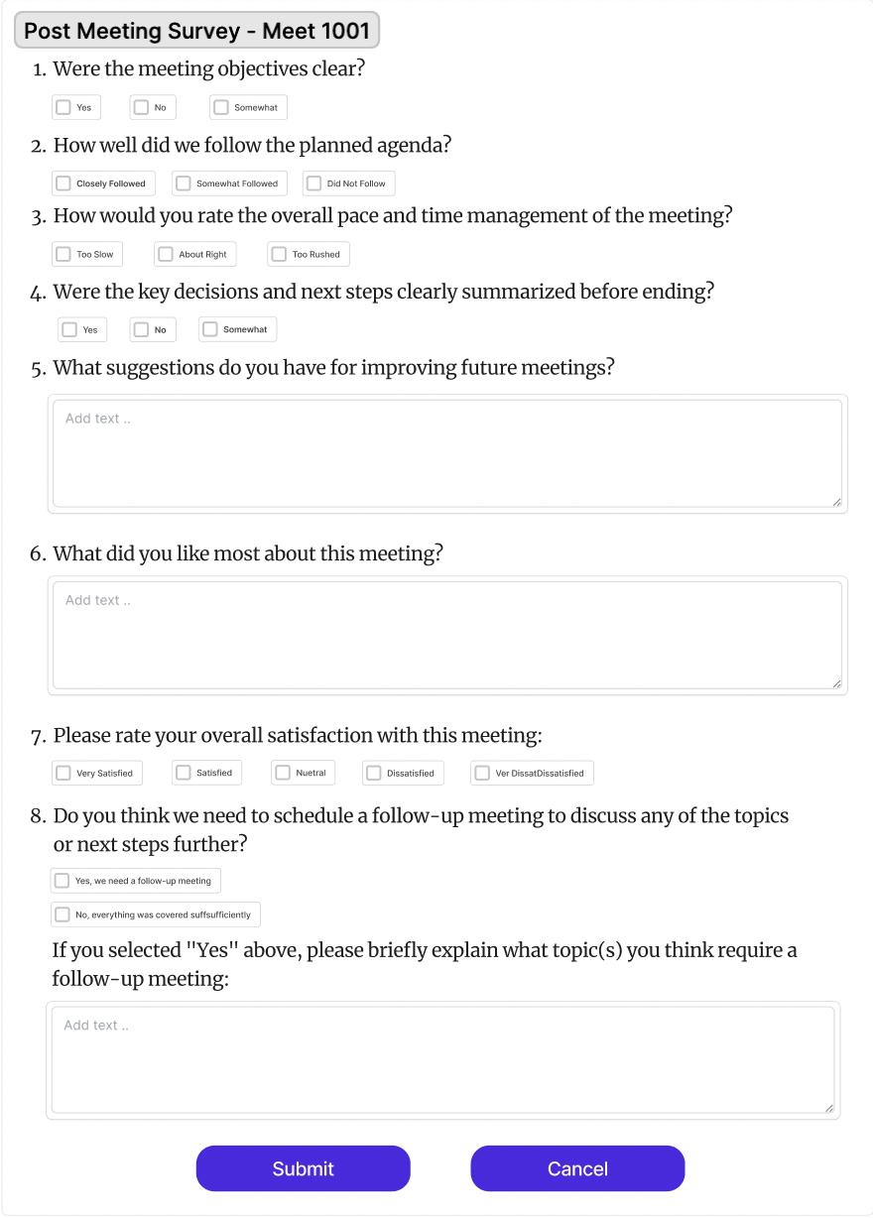
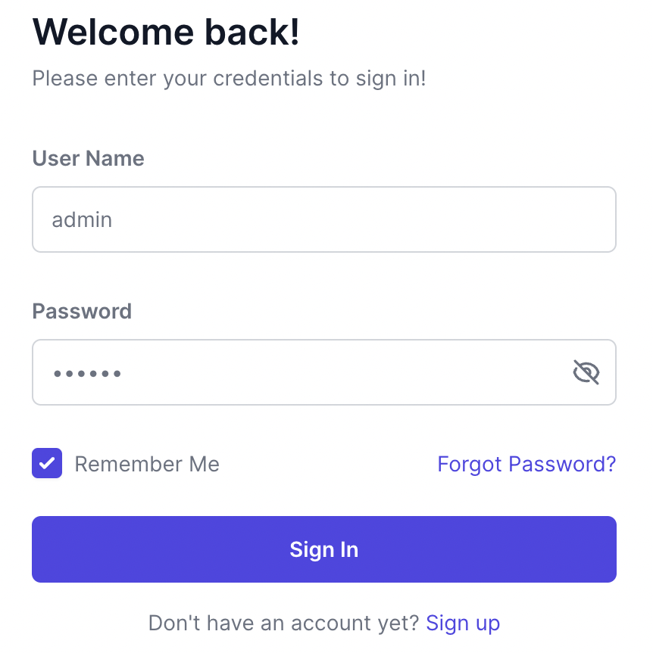
Input Design
Notes:
To use the system the user will first need to login. As most of the details are fetched automatically from Outlook and video conferencing applications, we will already have it in our database. After each meeting, we will send out optional feedback surveys to the participants. This feature will allow them to share suggestions, and request follow-up meetings for any unanswered questions.

Slide 11

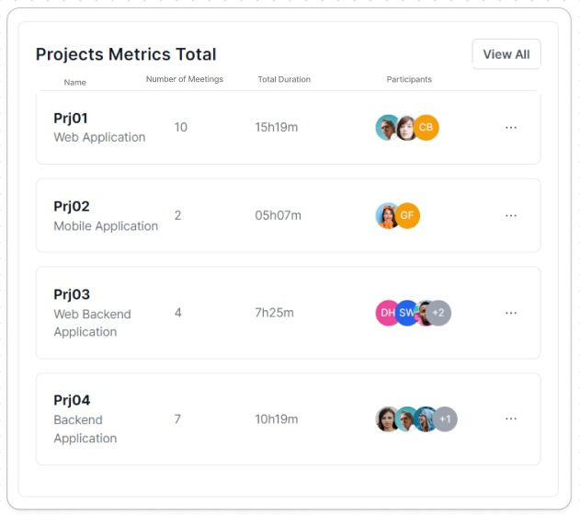
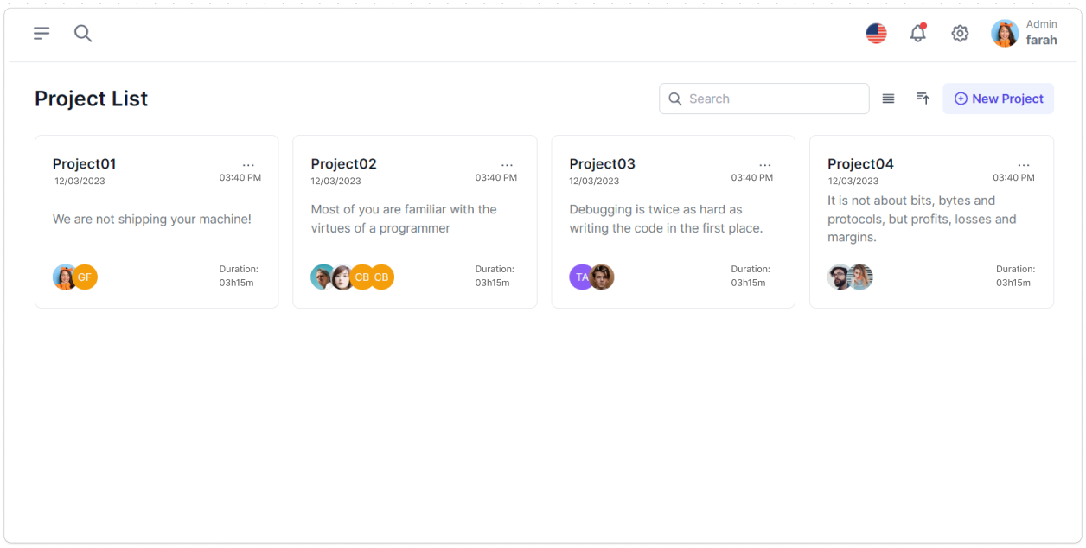
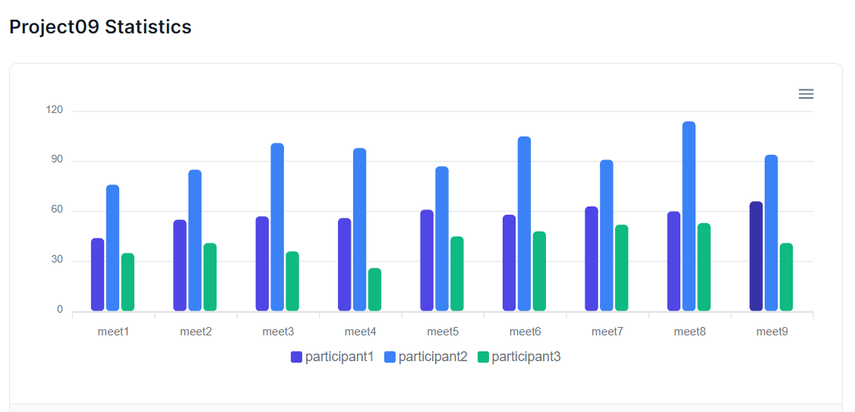
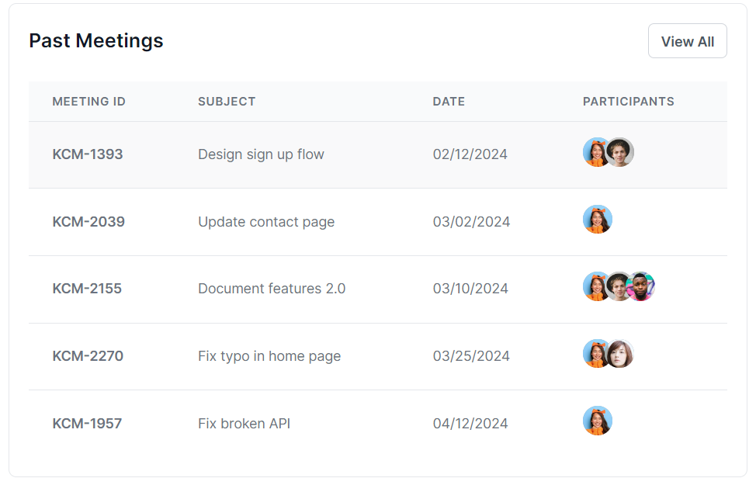
Output Design
Notes:
Upon landing on the dashboard, we'll see a list of all projects - with descriptions and team members. To view the progress of each project, we'll also show real-time metrics, including the number of meetings held and the total time spent till now. When we select a specific project, we can see the total time spent by each member in that project, along with we will show a list of all meetings with date, time, and attendance.

Slide 12

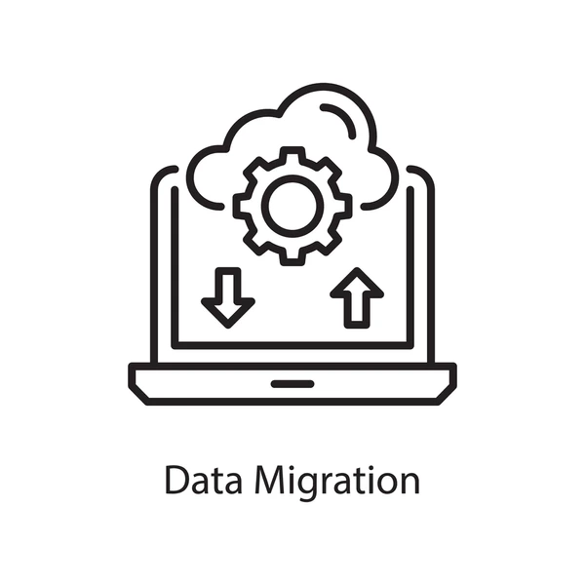



Implementation Plan
> Implementation Kick-off:
Software APIs, Cronjobs and AI tools (Firefly)
Dummy data from Trace3
Hardware components (Linux servers, supervisor)
> Installation and Configuration:
Deploying on host server
Setting up software and hardware
Integrating APIs and CRON Jobs
Configuring with Trace3's data
> Data Migration:
Transferring existing meeting data
Migrating Outlook calendar data
Integrating supplementary meeting data
> Testing:
Alpha testing
Beta testing with user involvement
> Go-Live, Hypercare & Transition:
Deploying on production servers
User transition from old to new system

Slide 13

THANK YOU!
Please let us know if you have any questions.

Slide 14
Appendix

Slide 15
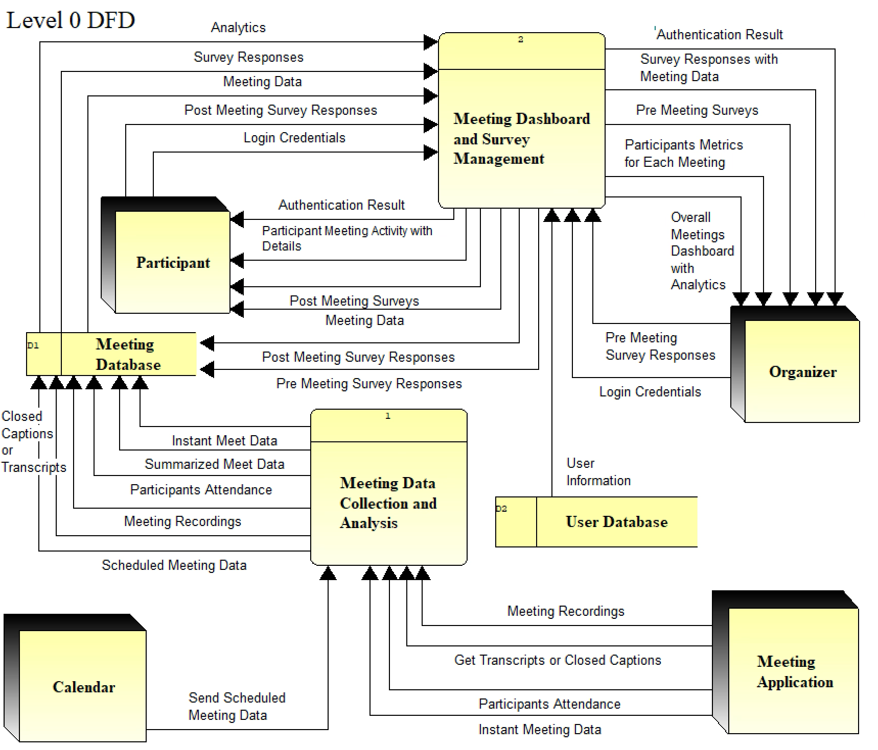
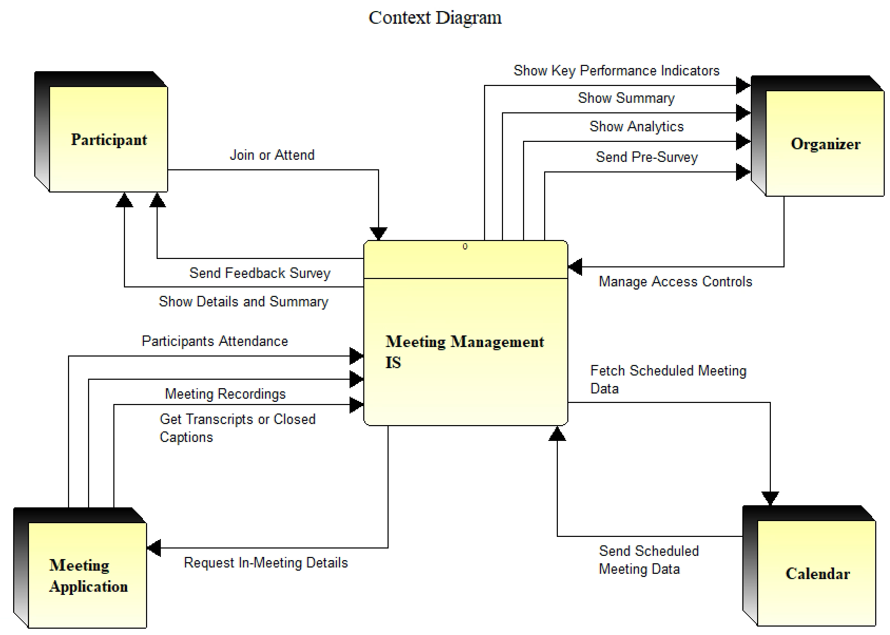
Data Flow Diagram

Slide 16
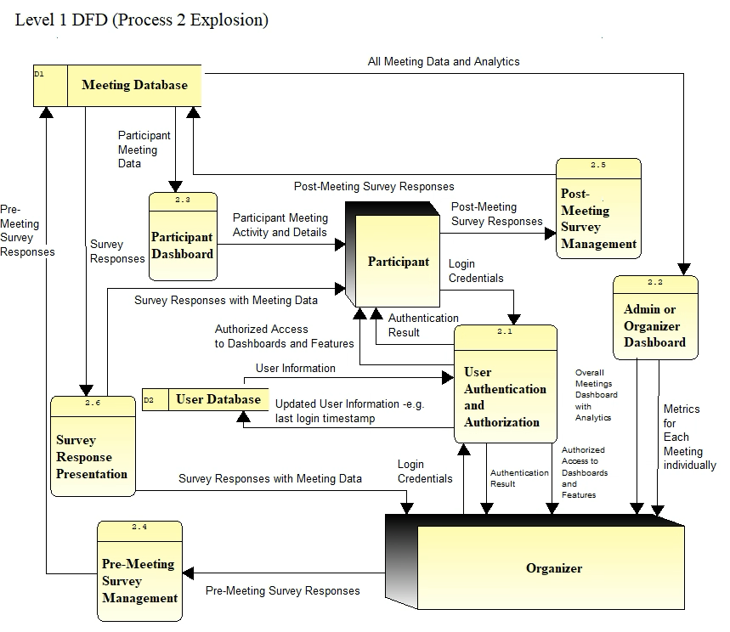
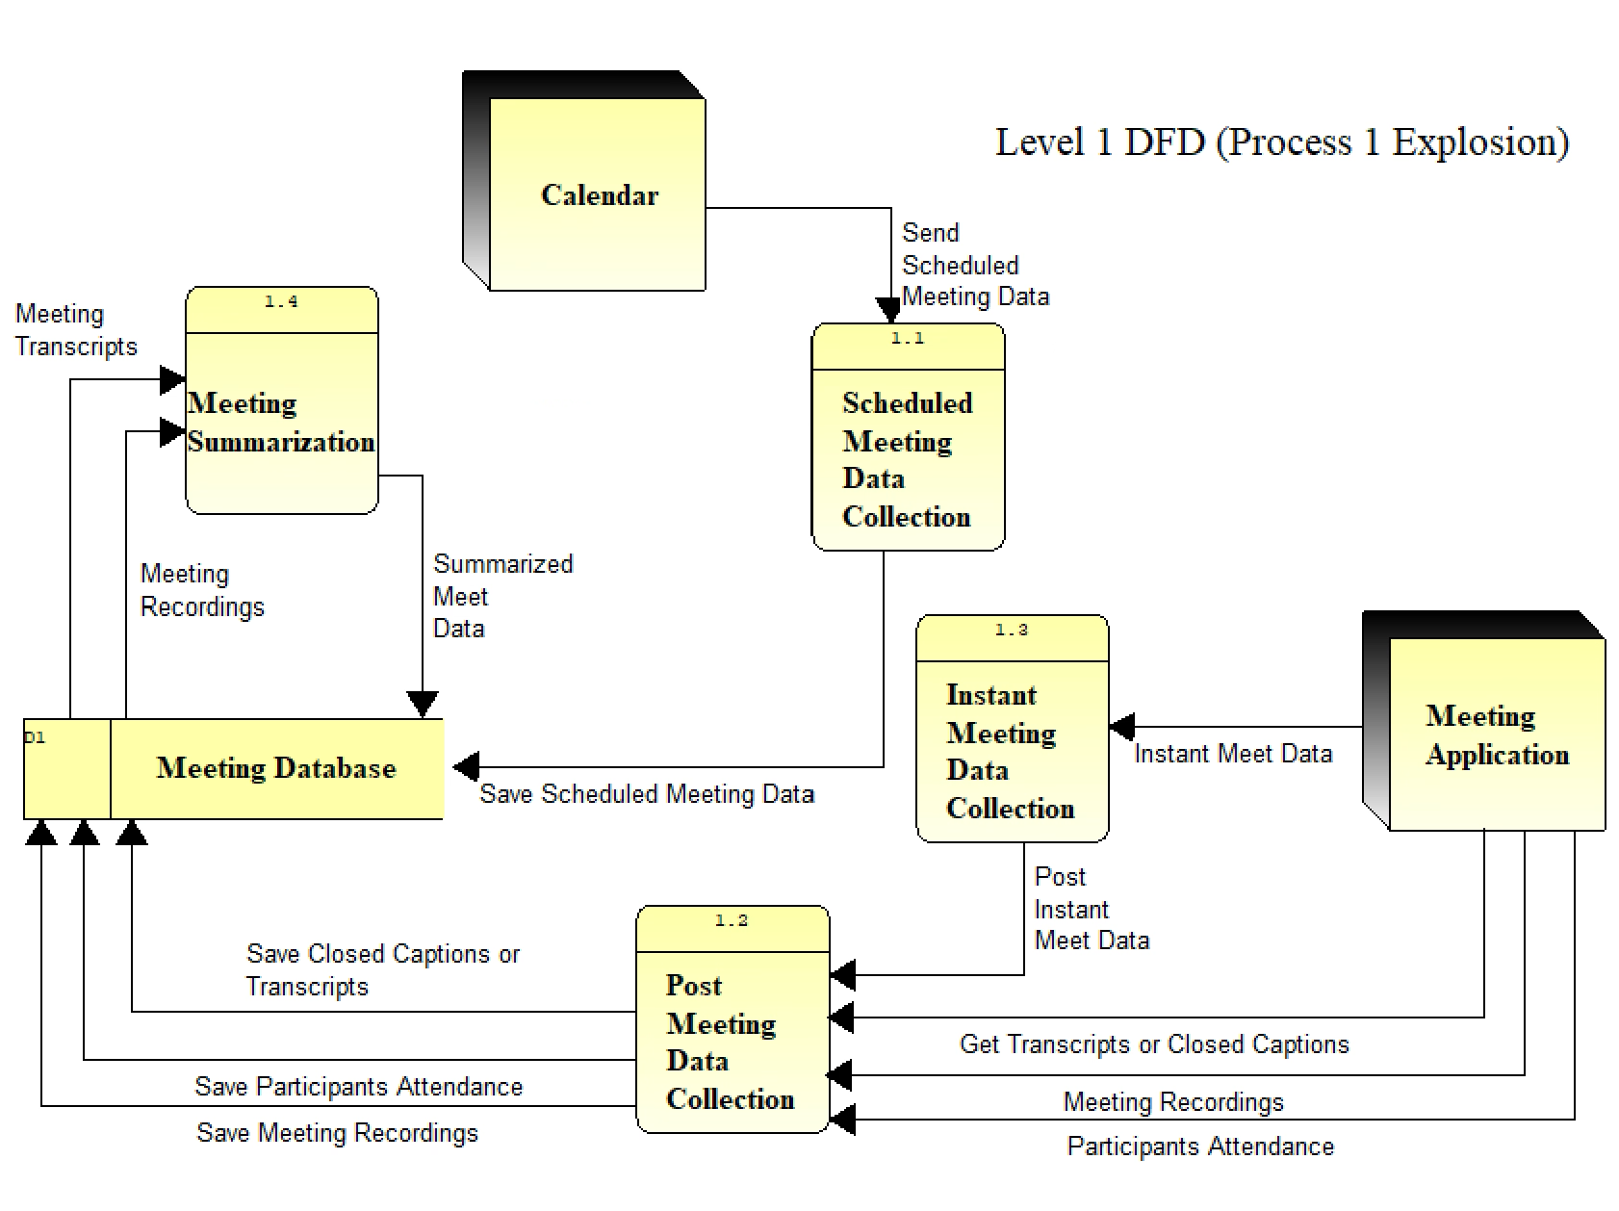
Data Flow Diagram

Slide 17
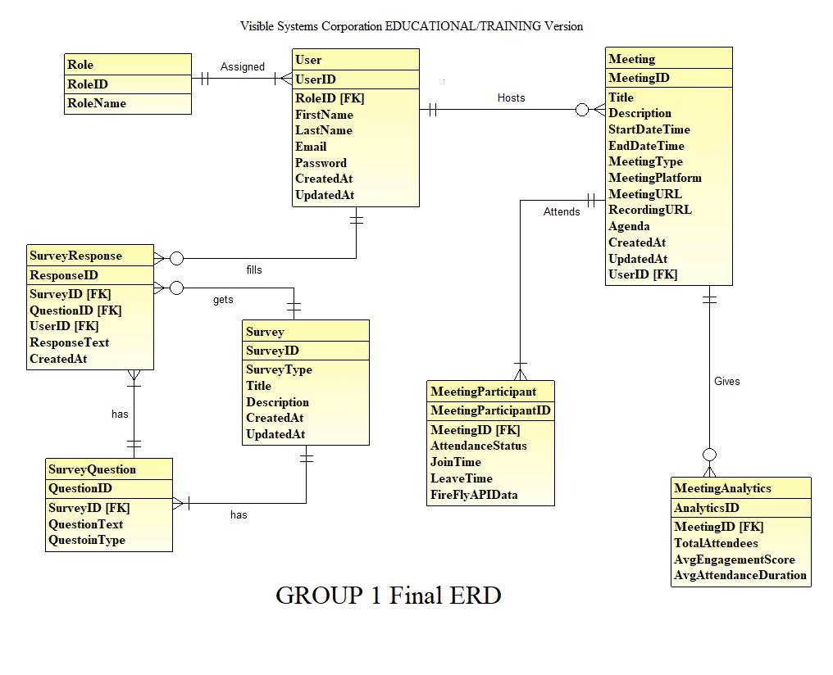
Entity Relationship Diagram

Slide 18
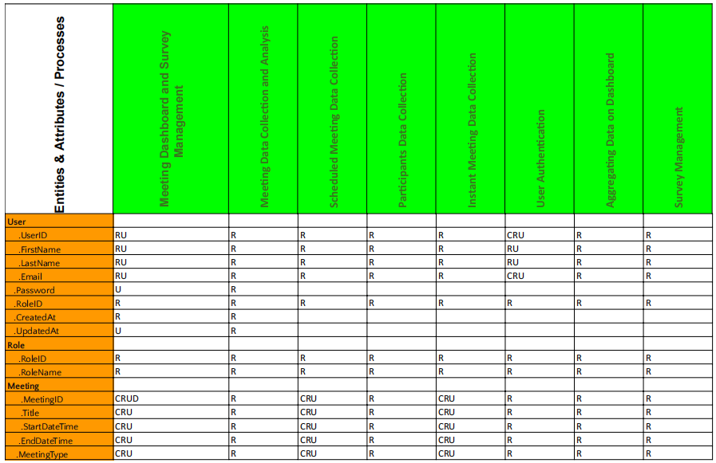
Synchronised Systems Model
(Data-to-Process CRUD Matrix)

Slide 19
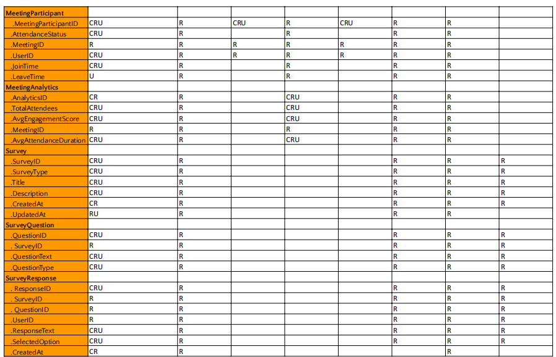

Slide 20
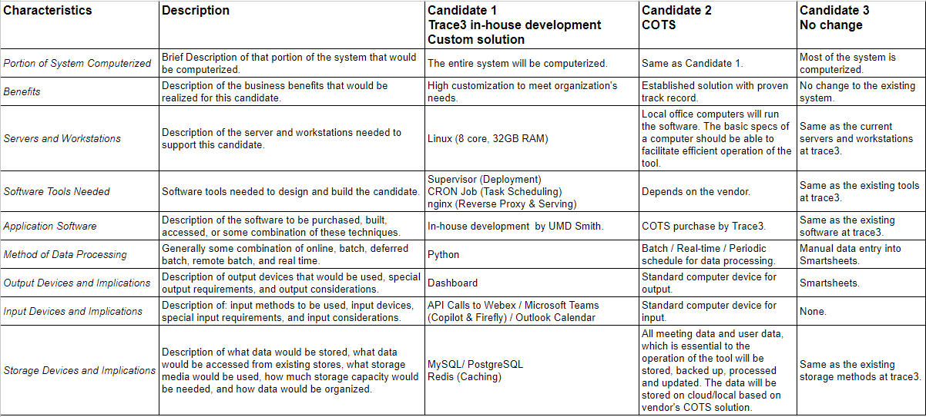
Candidate Solutions Matrix

Slide 21
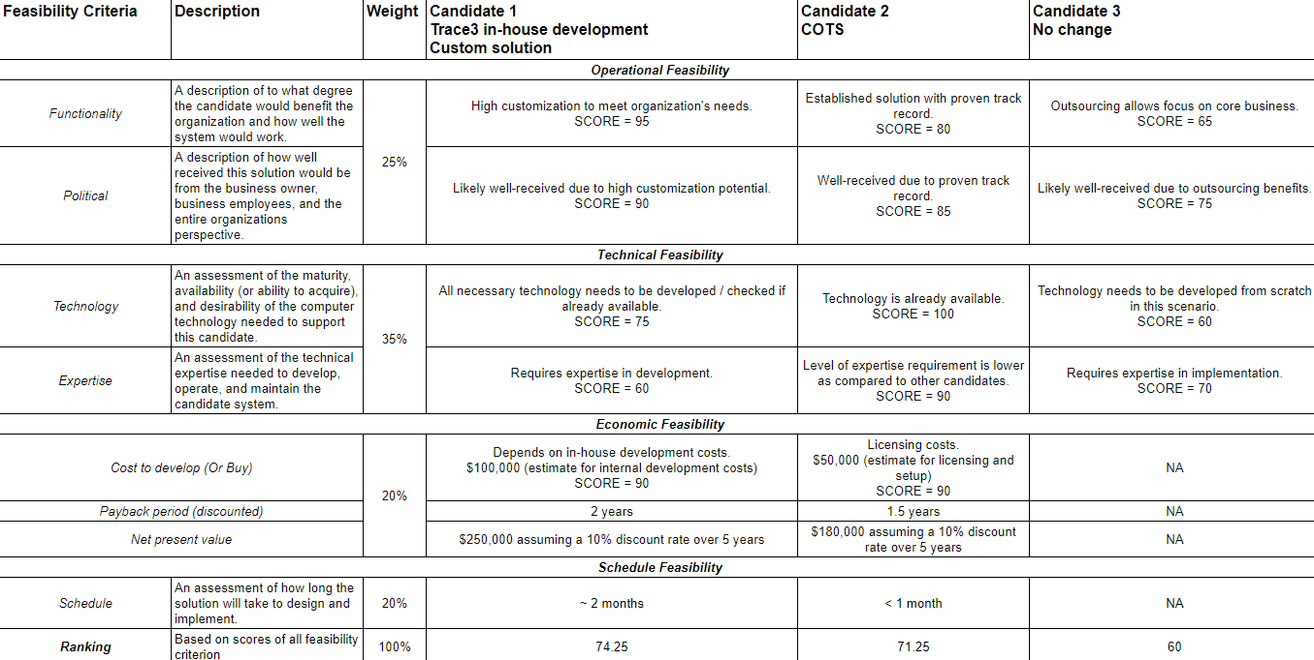
Feasibility Analysis Matrix

Slide 22
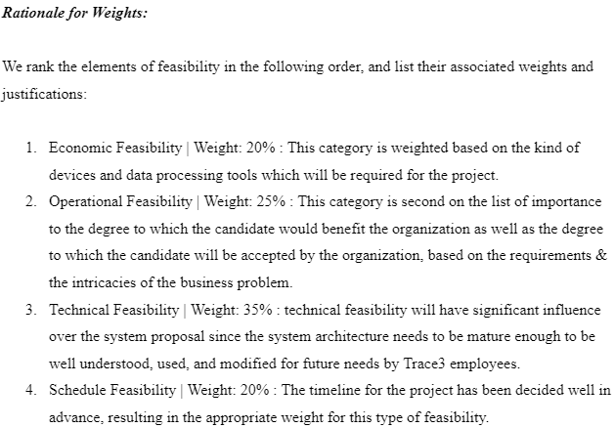
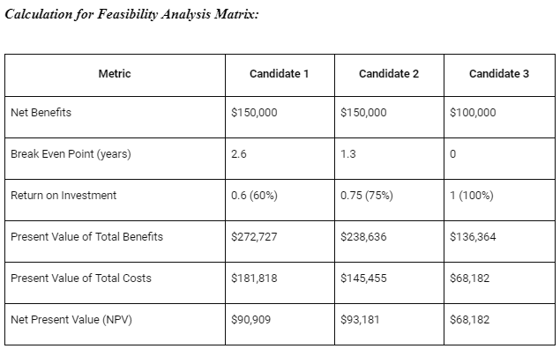
Feasibility Analysis Matrix

Slide 23
Lessons Learned
> Utilized Visible Analyst for DFDs and ERDs, enhancing understanding and communication.
> Emphasized visual aids' value in making technical info accessible.
> Stressed effective project management and teamwork.
> Adapted to evolving project scope with flexibility.
> Used fact-finding techniques to understand client needs thoroughly.
> Tailored system design to client's needs through active listening.
> Carefully evaluated and selected technologies.
> Overcame coordination challenges through open discussions.

